Slide 1
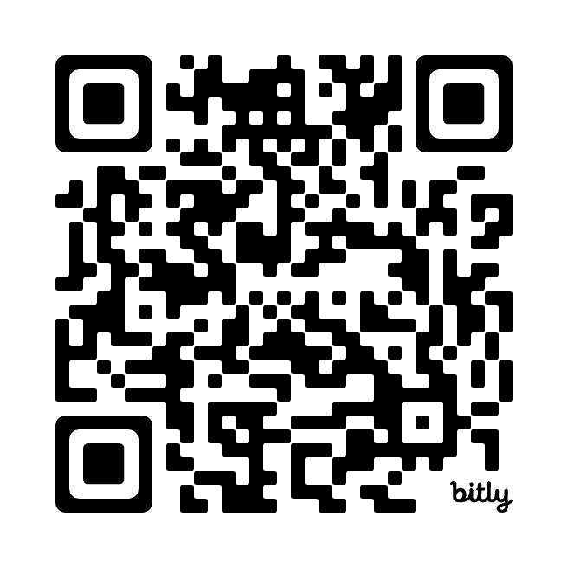
BEYOND ACCURACY, MORE THAN A MODEL: New Trends in AI for Neuroimaging Research
Qingyu Zhao, Ph.D
qiz4006@med.cornell.edu
Weill Cornell Medicine, Cornell University
Machine Intelligence in NeuroImaging (MINI) Lab
https://mini-cornell.github.io/

Slide 2
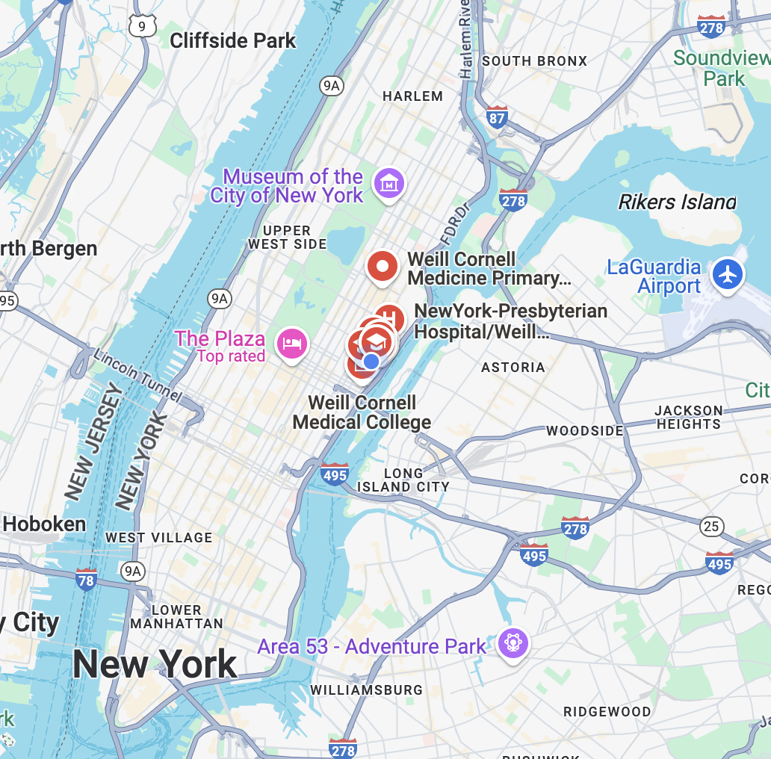



Cornell University
Weill Cornell Medical College
Cornell University (Ithaca)
Cornell Tech
Cornell Tech

Slide 3
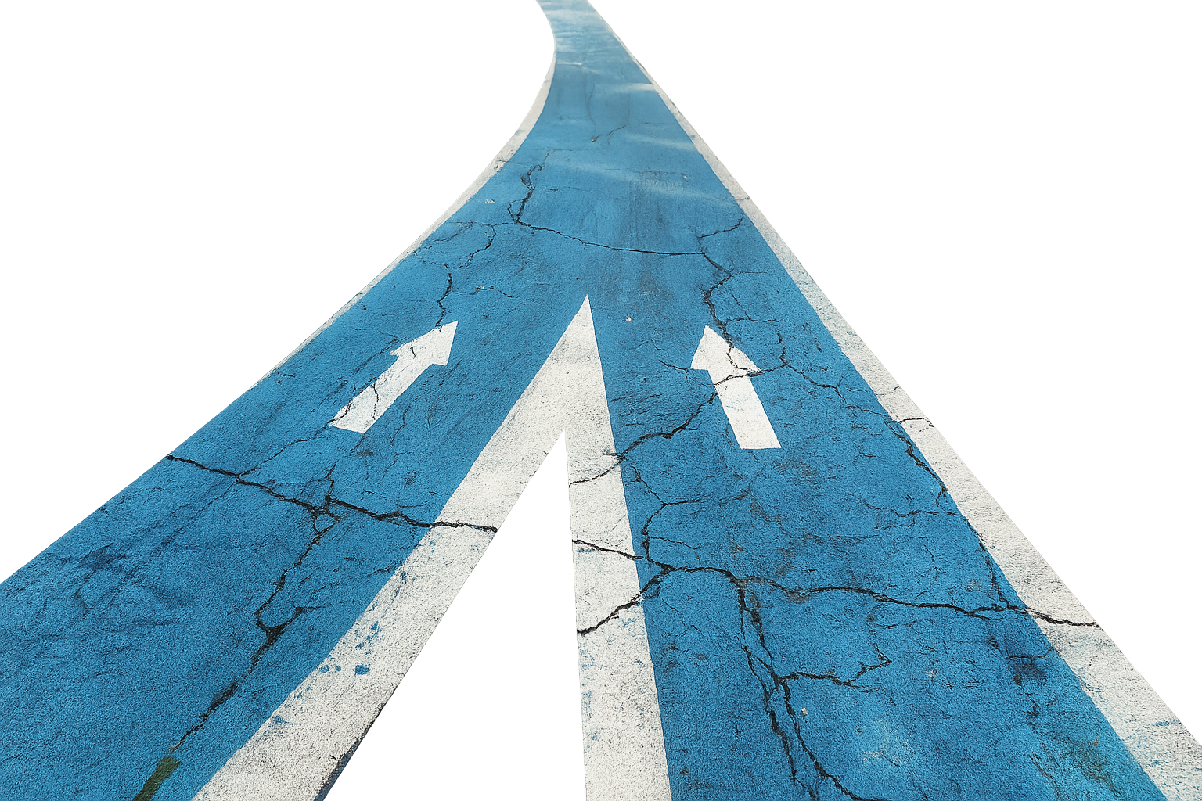


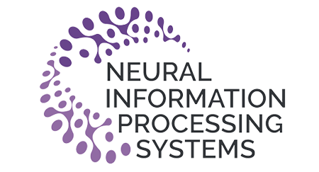


Design AI with Purpose
Healthcare
Needs
AI Trends

Slide 4

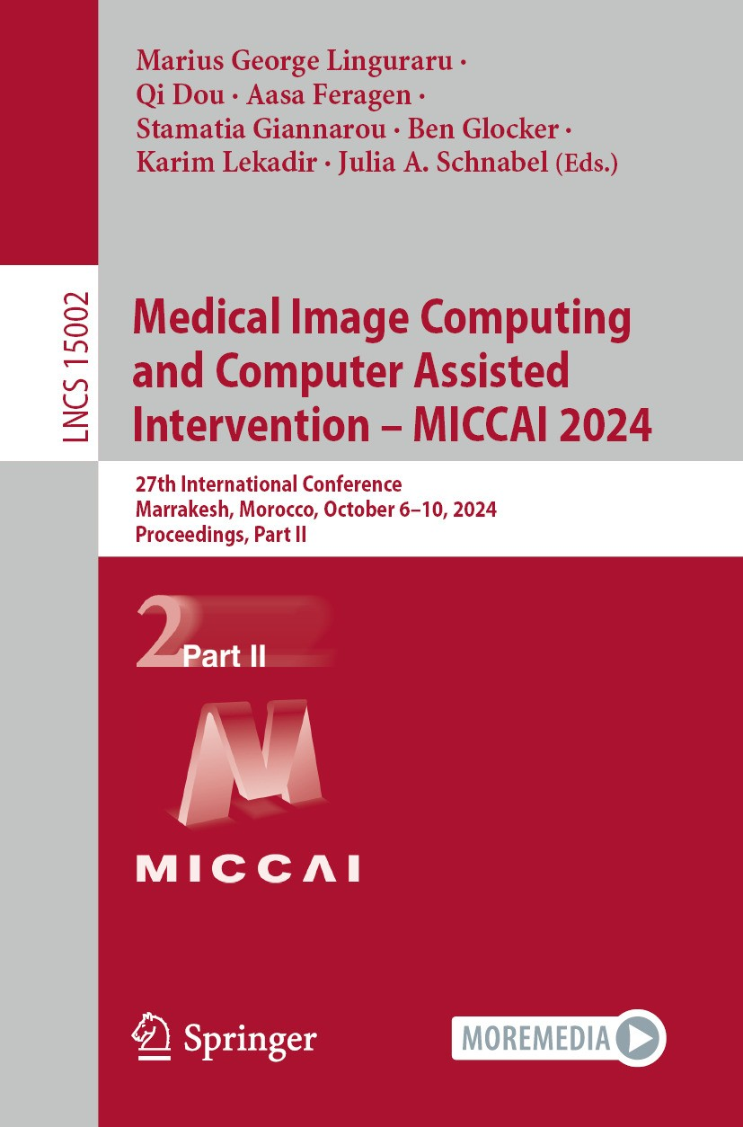
Medical Data
AI Trends

Slide 5
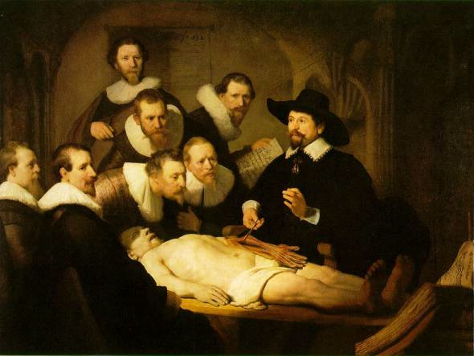
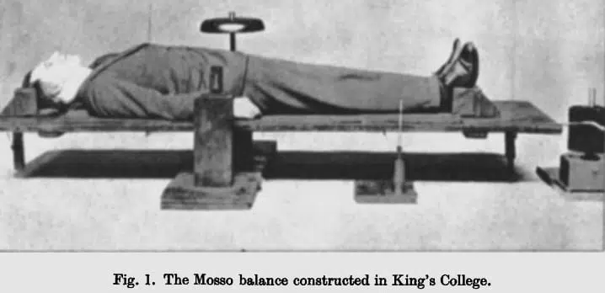
Neuroimaging in the Stone Age
Cut open & measure
1st “Neuroimaging” Technique (1880)
Human Circulation Balance: non-invasively measure the redistribution of blood during emotional and intellectual activity

Slide 6
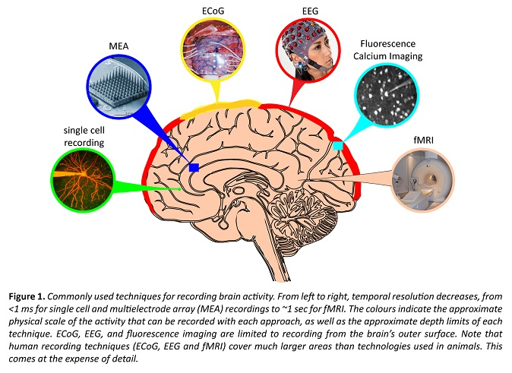
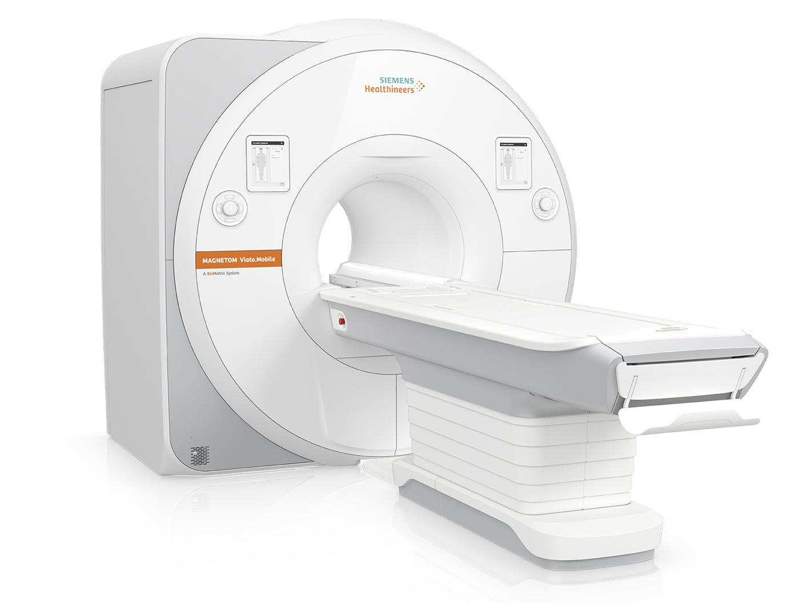
Neuroimaging Nowadays

Slide 7
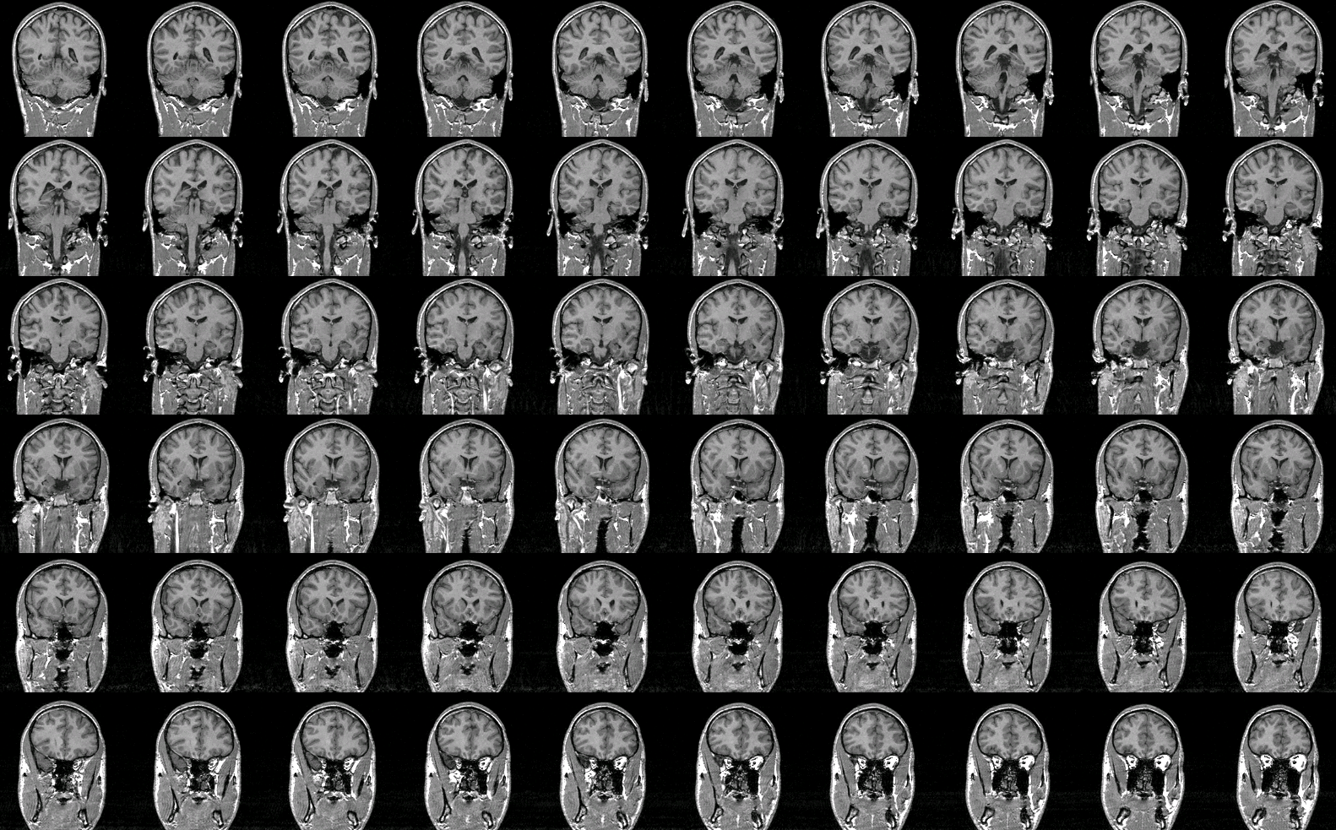
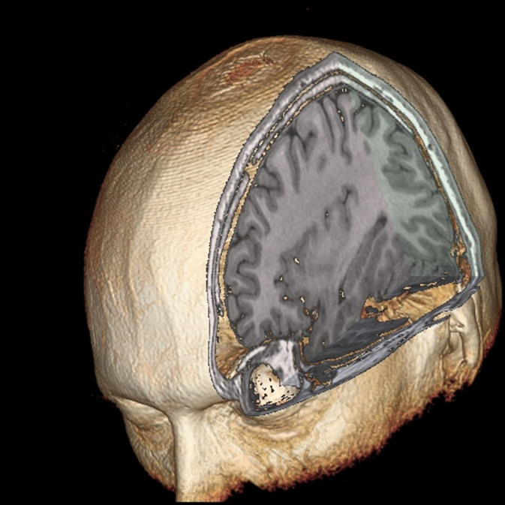
Structural MRI
wired.com

Slide 8
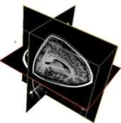
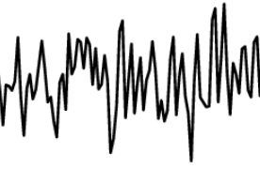
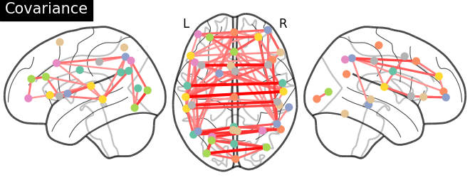
Functional MRI
An active brain region consumes more oxygen and causes more blood flow.
. . .
time
Start
2 sec
12 min
BOLD signal at A
A
time
B
BOLD signal at B
time
Functional Connectome

Slide 9



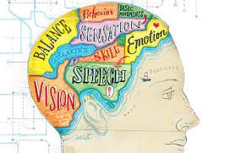
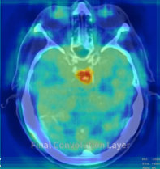
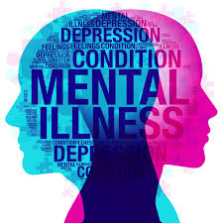
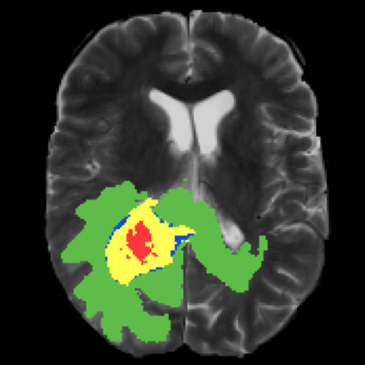
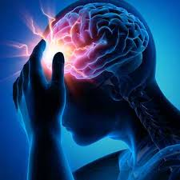
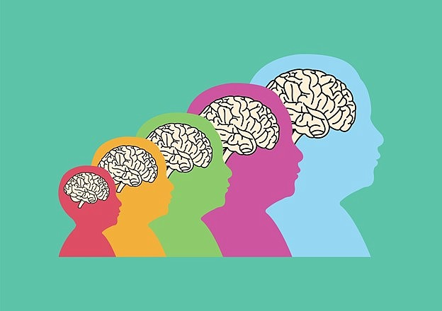
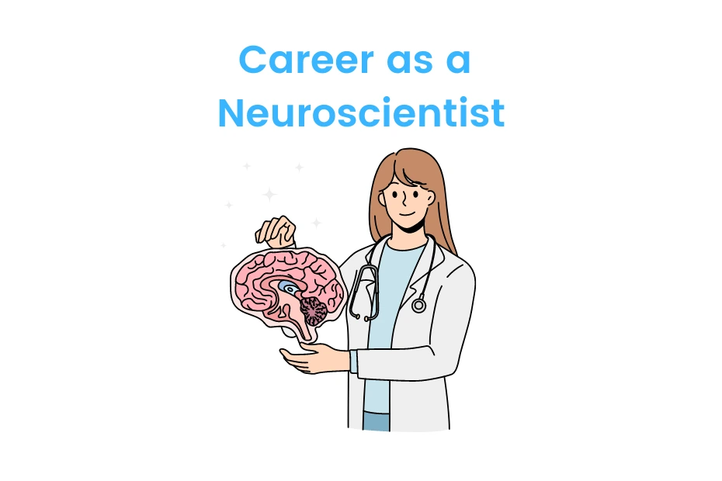

Preclinical Neuroimaging
Clinical Neuroimaging
Brain-Behavior Mapping
Neuropsychiatry
Lesion Segmentation & Detection
Diagnosis / Prognosis
Developmental Neuroscience

Slide 10



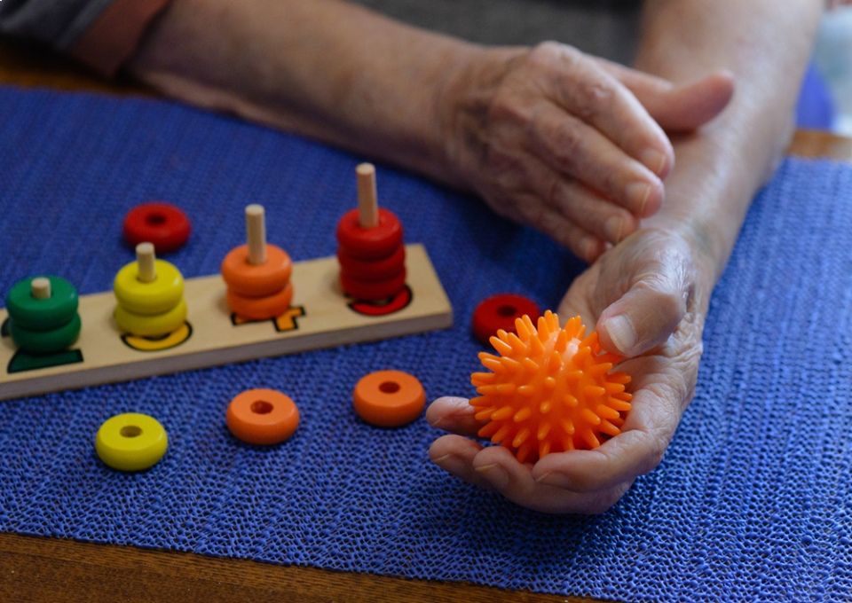
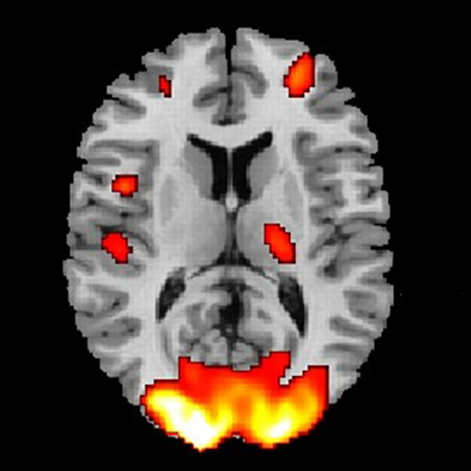
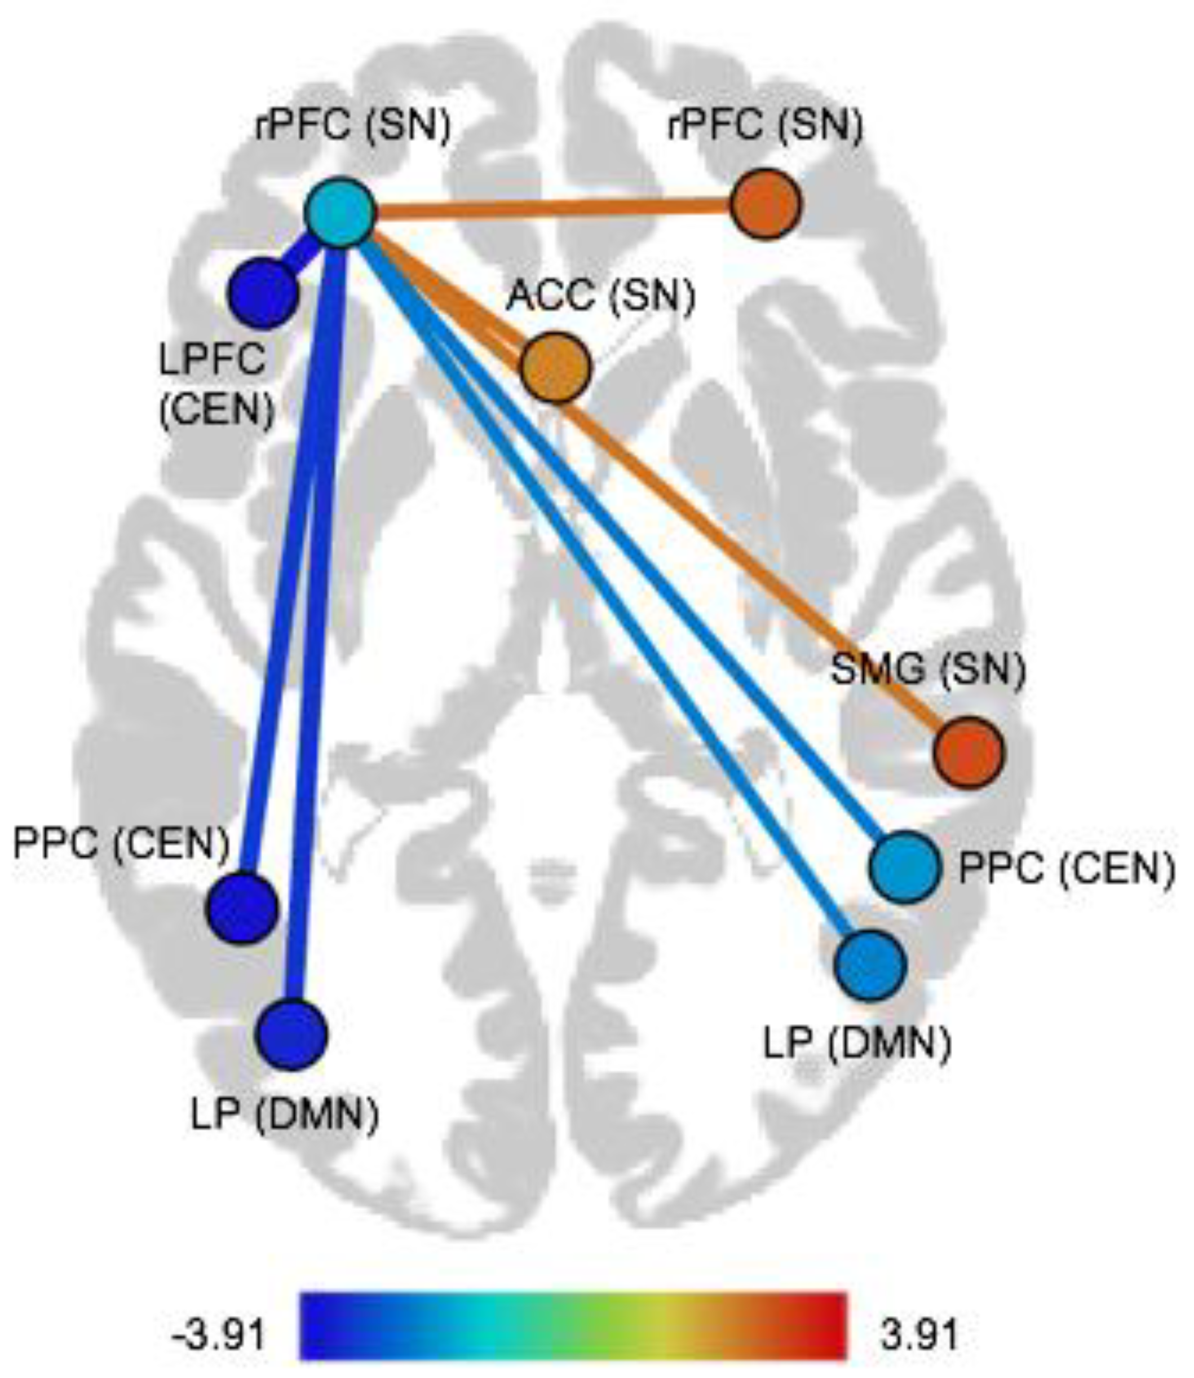

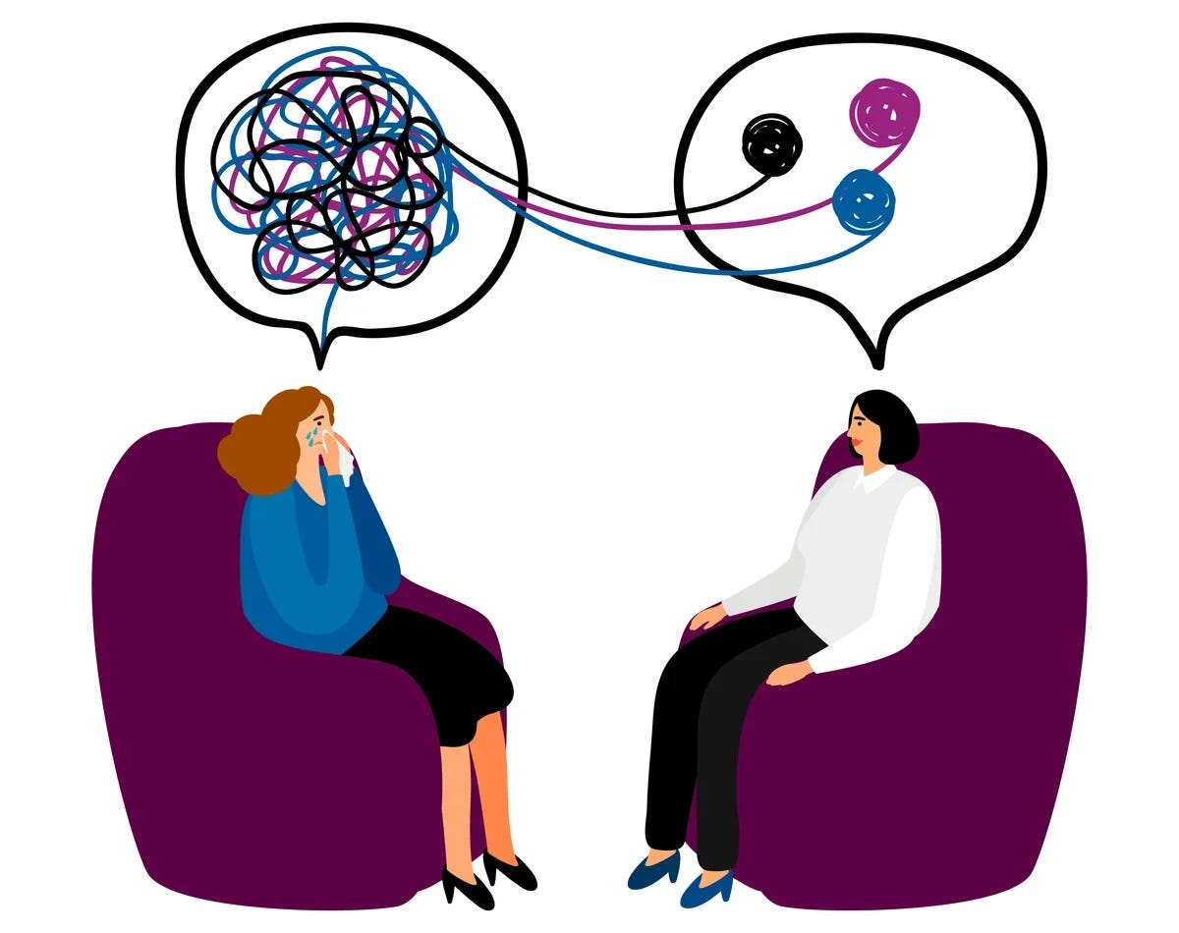
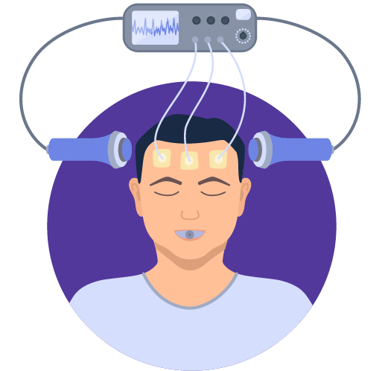
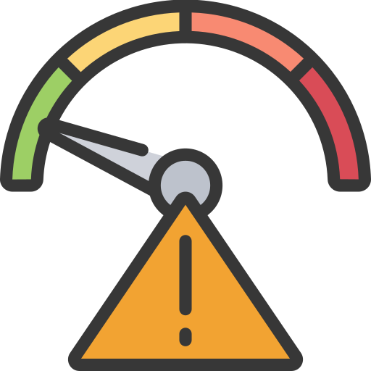
Brain Mapping / Brain-Wide Association Study (BWAS)
Brain mapping through neuroimaging studies:
Understand brain mechanisms underlying neurological symptoms
Objective diagnosis tools
Prevention/intervention programs
Screening / prognostic tools
Predict treatment response
Diagnosis
Behavior
Neuroimaging
Cognition
Neural Mechanisms
Therapy
Intervention
Risk Assessment
Treatment Response

Slide 11



What should be the trends?
Traditional ML
Deep Learning
Hypothesis Testing
Self-Supervised Learning

Slide 12
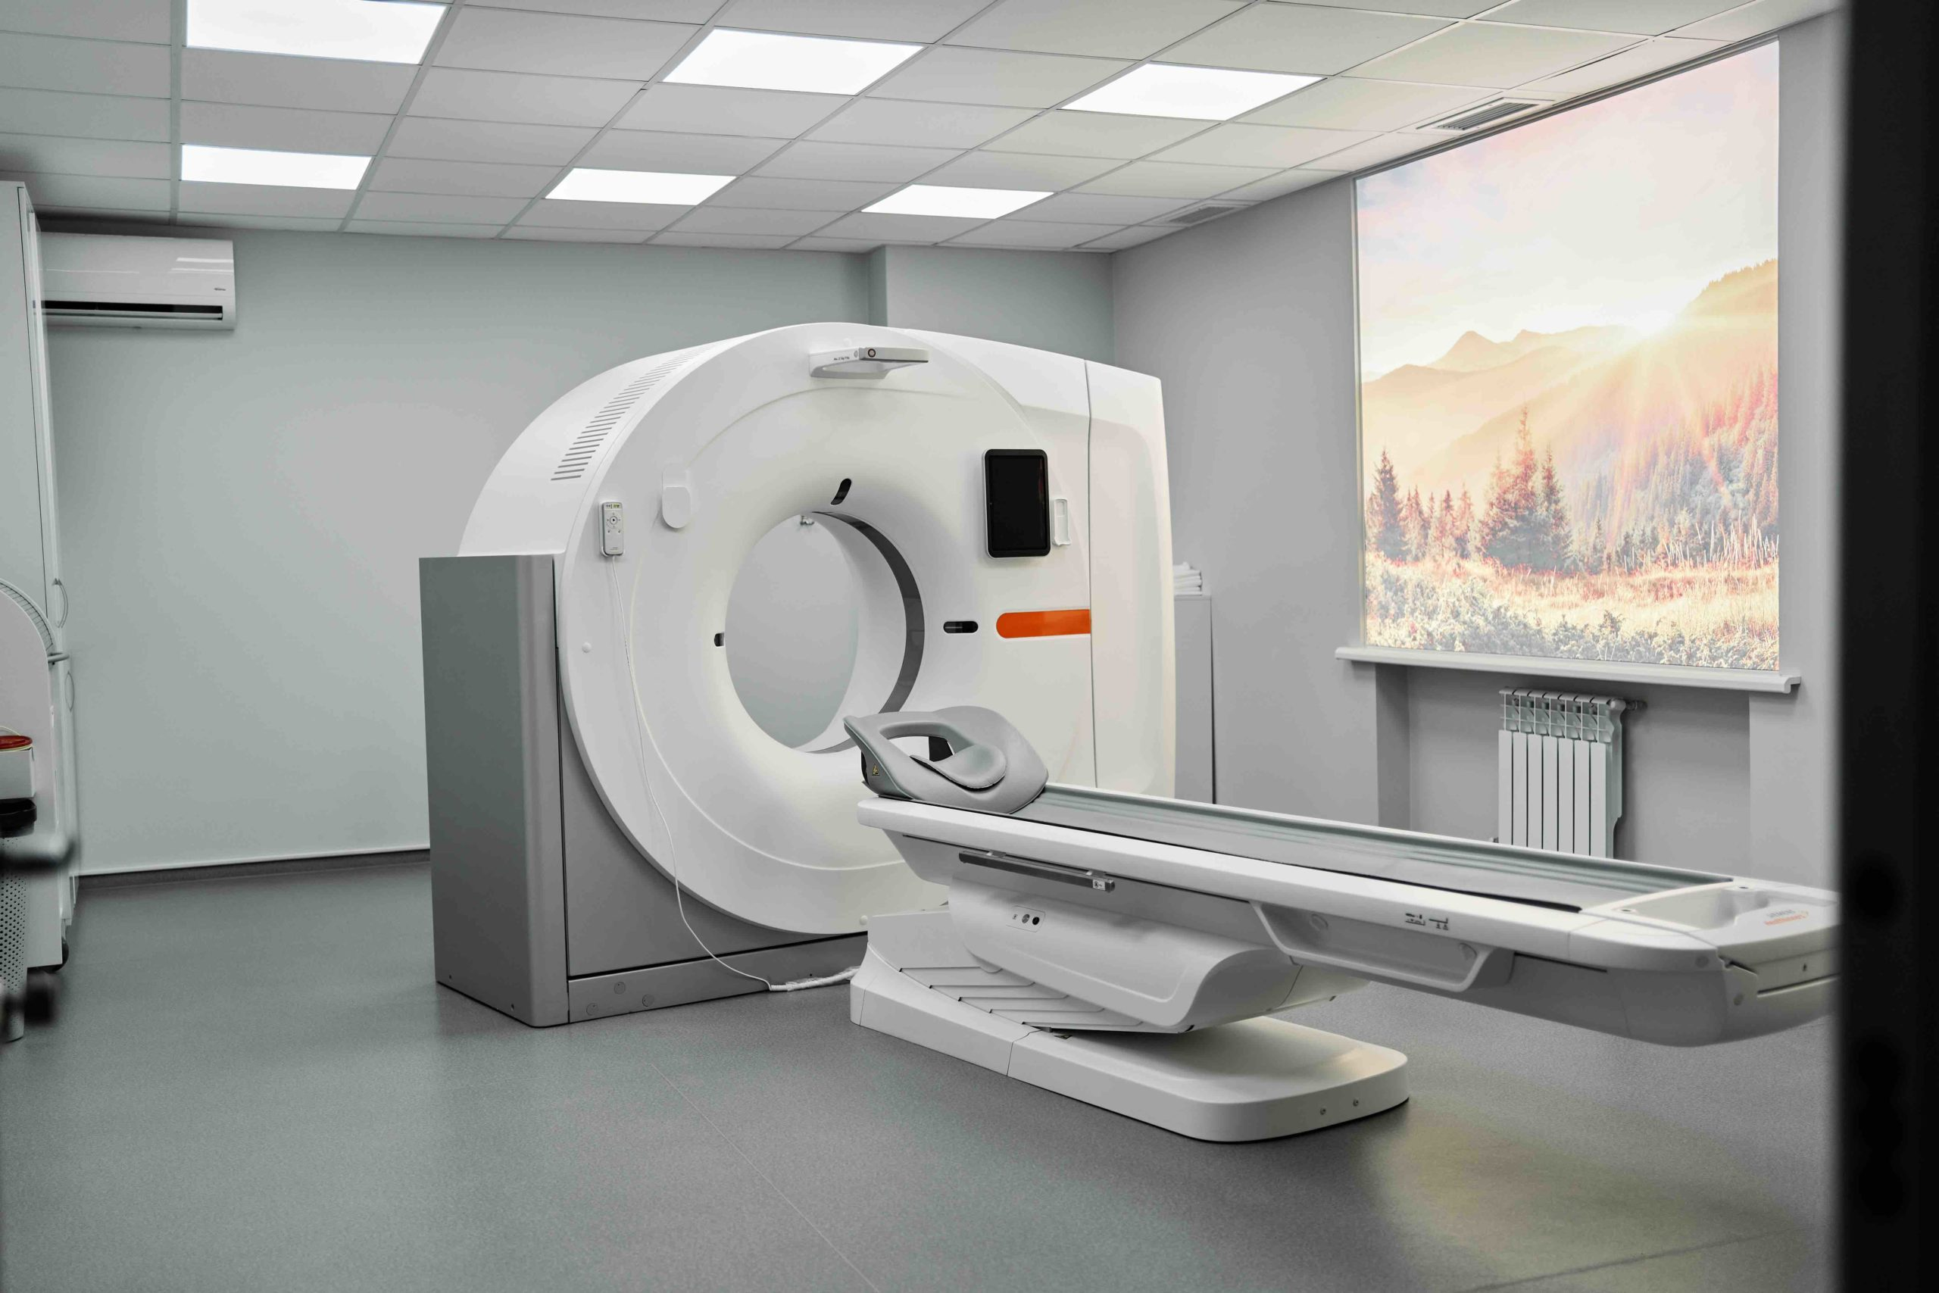
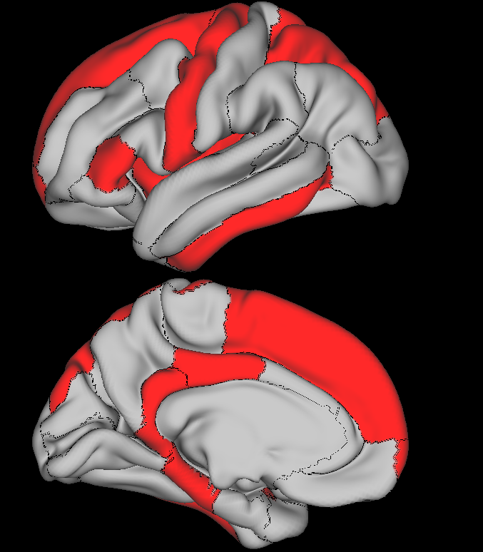


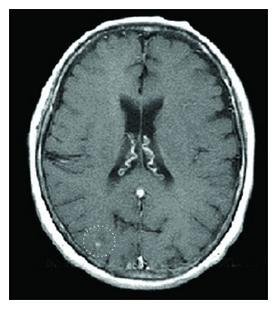
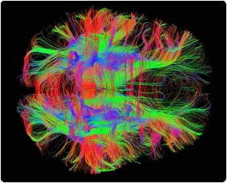
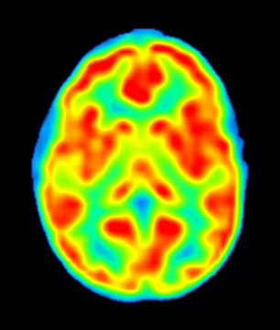


Brain Mapping
Control
Patients
Participants
Hypothesis test
……
……
…
Measurements
…
…
……
Data Processing
Hypothesis test
Data Collection
Easy to interpret
Population-level inference
Univariate analysis

Slide 13
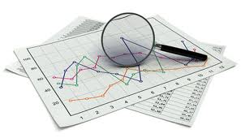
Brain-Based Predictive Modeling
Participants
……
……
Machine Learning
Model
Measurements
…
…
……
Data Processing
Label Participant
Model
Interpretation
Data Collection
Healthy
Diseased
Subject-level inference

Slide 14
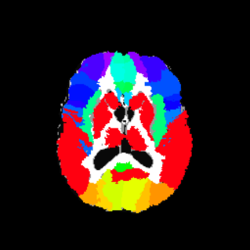
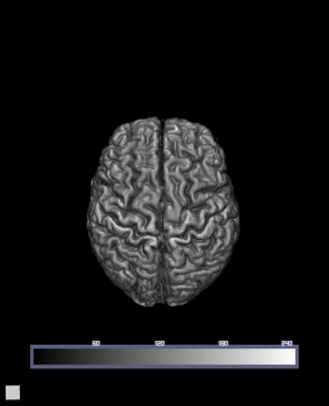
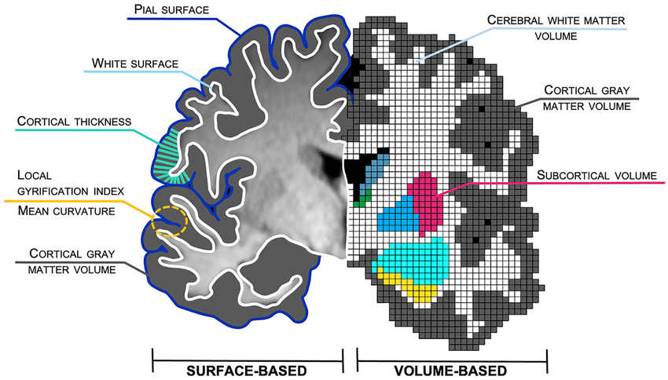
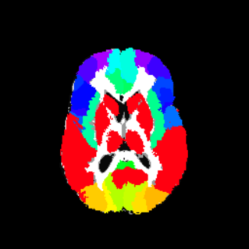
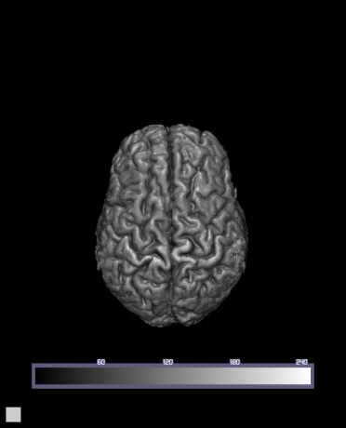
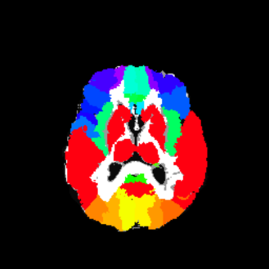
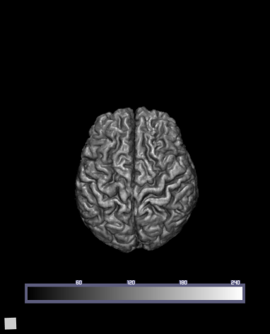
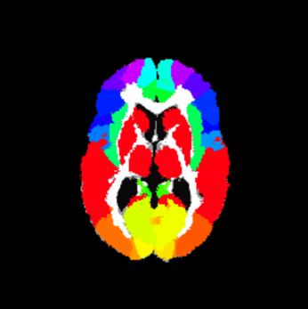
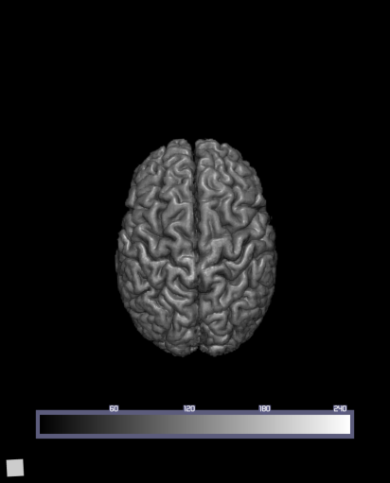
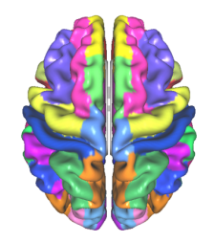
Brain-Based Predictive Modeling
T1 MRI
Segmentation
Feature Extraction
.
.
.
.
.
.
Backhausen, et al. Neuropsychology Review, 2022
Atlas registered to each subject

Slide 15
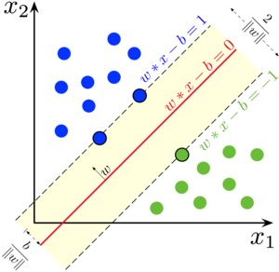
Brain-Based Predictive Modeling
T1 MRI
Segmentation
Support Vector Machine
Random Forest
LASSO
…
Feature Vectors
 |  | …
 |  | …
X
y
1
0
1
.
.
.
0
.
.
.
 |  | …
.
.
.
.
.
.
.
.
.
 |  | …
Atlas registered to each subject

Slide 16
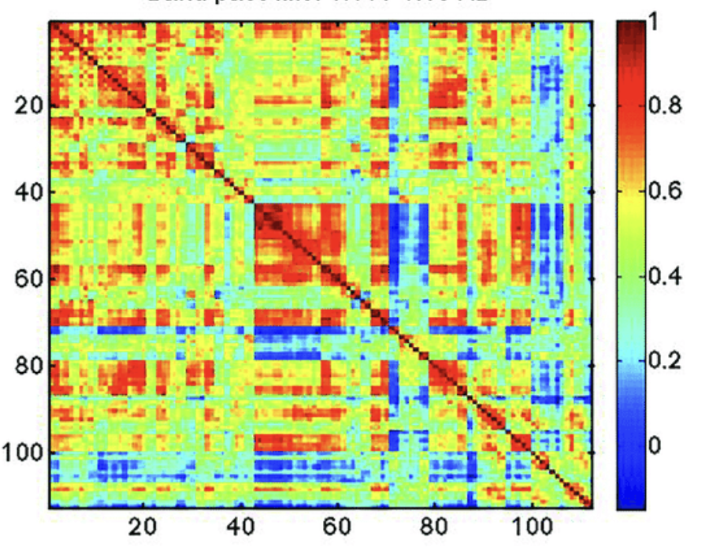
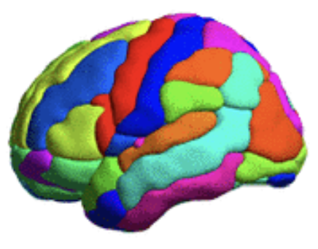
Brain-Based Predictive Modeling
Mean BOLD signal at region A
Functional Connectivity
X
y
Flattening
1
0
1
.
.
.
0
.
.
.
Mean BOLD signal at region B

Slide 17
Brain-Based Predictive Modeling
Participants
……
……
Machine Learning
Model
Measurements
…
…
……
Data Processing
Label Participant
Model
Interpretation
Data Collection
Healthy
Diseased

Slide 18
Brain-Based Predictive Modeling
Deep Learning
Model
Label Participant
Model
interpretation
Data Collection
Healthy
Diseased
Subject-level inference

Slide 19


Deep Convolutional Networks

Slide 20
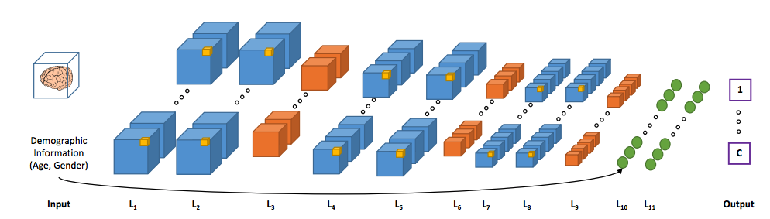
Deep Convolutional Networks
Control
MCI
Alzheimer’s
Esmaeilzadeh et al. End-To-End Alzheimer’s Disease Diagnosis and Biomarker Identification, MLMI 2018

Slide 21
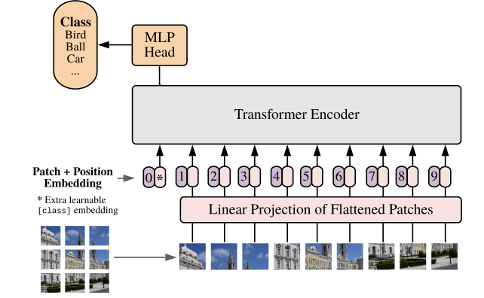
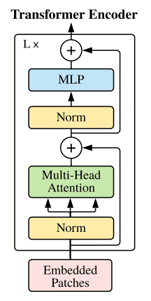
Vision Transformers (ViT)
Dosovitskiy, et al. ICLR 2021

Slide 22
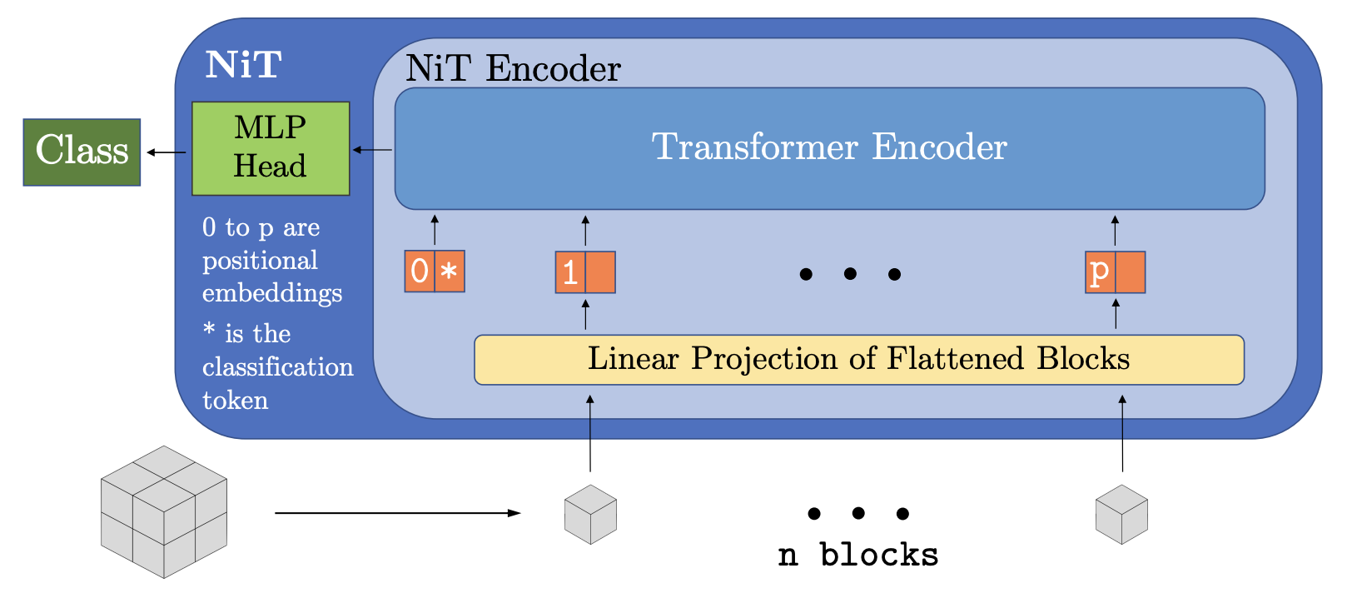

Vision Transformers (ViT)
Singla, et al. Multiple Instance Neuroimage Transformer, Pred. Intel. Med. 2022

Slide 23


Graph Convolution for fMRI Analysis
Connectivity Matrix
Image-based Convolution
Graph Convolution
Graph Representation

Slide 24


Graph Convolution for fMRI Analysis
Li et al., BrainGNN, Medical Image Analysis 2022

Slide 25


Spatio-Temporal Graph Convolution
fMRI is 4D signal !
time
T
Healthy
Patients
Spatio-Temporal Graph Convolution
Spatial Graph
4D BOLD
Gadgil et al. Spatio-Temporal Graph Convolution for Resting-State fMRI Analysis, MICCAI 2020

Slide 26

Transformers for Functional MRI
Bedel, et al. MedIA 2023

Slide 27


“New Trends” in AI ?
# of ML Studies for Alcohol Use Disorder between 2015-2025
Stanford HAI 2025 AI index report

Slide 28






Beyond Accuracy, More than a Model
HIV Patients
ML Grind
Best Accuracy
So What?
Health Controls
For many brain disorders, neuroimaging is NOT used for diagnosis and treatment settings

Slide 29







Design AI with Purpose
Heterogeneity
Can I build this?
Loss function
Accuracy
Baselines
Ablations
…
Will it matter?
Clinical relevance
Scientific relevance
Generalizability
Transparency
…
Generalizability
Comorbidity
Multi-modality (Non-Imaging)

Slide 30


Small Sample Sizes, Limited Generalizability
1,500 scientists lift the lid on reproducibility
NIH Primary Aim: Establish reproducibility
Big data in Neuroimaging is not “big” enough.
Traditional R01s recruit ~100 participants.

Slide 31

Self-Supervised Learning
Pre-train model on massive unlabeled data
Using learned representations for downstream tasks
Pre-train (massive unlabeled data)
Downstream classification (small labeled data)
Healthy
Patients
Encoder
g
 |  | …

Slide 32

Self-Supervised Learning
Contrastive Learning
Latent Space

Slide 33










LSSL: Longitudinal Self-Supervised Learning
Longitudinal data should follow coherent aging trajectories in the latent space
time
Learned
Representation Space
$$z1$$
$$z2$$
Encoder
$$z3$$
$$z4$$
g
$$z1$$
$$z2$$
time
$$z3$$
Aging
$$Ω_{z}$$
Zhao* et al. Longitudinal Self-Supervised Learning, Medical Image Analysis, 2021
Kim, Learning-based inference of longitudinal image changes: Applications in embryo development, wound healing, and aging brain, PNAS 2025

Slide 34



Unbiased Brain Age Estimate
time
LSSL
time
time
Downstream Tasks
Brain-age Estimate
Longitudinal Data
62.9 65.0 71.3 75.3 82.1 86.1 92.5
Health Controls
Chronological age = 80
Zhao et al., Longitudinal Self-Supervised Learning, Medical Image Analysis, 2021

Slide 35

Masked Autoencoders
He, et al. Masked Autoencoders Are Scalable Vision Learners. CVPR 2021
19

Slide 36

Masked Autoencoders for Functional MRI
Milecki et al., NERVE: Network-Aware Representations of Brain Functional Connectivity via Masked AutoEncoders, Under Review

Slide 37

Masked Autoencoders for Functional MRI
Functional Connectivity Matrix
Caro, et al. BrainLM, ICLR 2024
BrainLM, Brain-JEPA, …
BrainMASS

Slide 38

Accuracy-Centric Evaluation
Yang, et al. BrainMass, TMI 2024

Slide 39

Neuroimaging-based Prediction in Mental Health
Aggarwal et al. Diagnostic accuracy of deep learning in medical imaging: A systematic review and meta-analysis. NPJ Digit Med. 2021
100%
90%
Alzheimer’s
80%
Prediction Accuracy
Psychosis
Substance use disorder
ADHD
70%
60%
50%
Random guessing

Slide 40


Neuroimaging-based Prediction in Mental Health
Classification Accuracy
Fluid Intelligence Regression
Varoquaux, Cross-validation failure: Small sample sizes lead to large error bars
Marek et al., Nature 2022

Slide 41

Population Heterogeneity
Marquand et al. Understanding Heterogeneity in Clinical Cohorts Using Normative Models: Beyond Case-Control Studies, Bio. Psyc. 2016

Slide 42
Population Heterogeneity
Small studies tend to be homogeneous;
In larger studies, external factors can influence brain-behavior mapping
Sex differences
Community environment
Education
Socioeconomic status
Parental monitoring
…
Confounder
Brain
Behavior
Moderator

Slide 43
Unbiased, Fair, Invariant, Confounder-Free Learning
Confounders affect the relationship between input and output variables (e.g., diagnosis).
Improper modeling of those relationships often results in spurious and biased associations.
Widely studied in traditional statistical analysis but overlooked in deep learning applications
Confounder
Association
Association
Input
Output
Diagnosis
Zhao*, Adeli* et al. Nature Communications 2020

Slide 44

Unbiased, Fair, Invariant Confounder-Free Learning
Confounder
Remove direct link
Brain
Diagnosis
Zhao*, Adeli* et al. Nature Communications 2020
Shah et al, Confounder-Free Continual Learning via Recursive Feature Normalization, ICML 2025
Adversarial learning of features F that are
Predictive of target of interest
Unpredictive of confounder / bias variables

Slide 45




Failure of the “one-size-fits-all” paradigm
Confounder
Brain
Behavior
Moderator
Universal Model ?
Greene et al., Brain–phenotype models fail for individuals who defy sample stereotypes, Nature 2022

Slide 46





Heterogeneous ML
Population-Specific Models
Hypernetwork-based Model
Brain
Behavior
Predictive
Moderation
External Factors
(demographic, social, environmental, etc)
Zhao et al. The Transition From Homogeneous to Heterogeneous Machine Learning in Neuropsychiatric Research, Biological GOS 2024

Slide 47





Subtypes of Brain-Behavior Association
Sex Difference
Sensorimotor
Salience
Cortical Connectivity
Adverse Childhood Experiences (ACE)
Sensorimotor
Cingulo-Parietal
Basal Ganglia
Connectivity to Sub-cortical Regions
Milecki et al., Heterogeneous brain functional mapping of childhood psychiatric symptoms, SfN 2024 Press Highlight
Milecki et al., Regularized CCA Identifies Sex-Specific Brain-Behavior Associations in Adolescent Psychopathology Trans. Psyc. 2025

Slide 48

Data-Driven Sample Weighting
Sample weights reveal predictability of sub-cohorts
Paschali, et al., Spectral Graph Sample Weighting for Interpretable Sub-cohort Analysis in Predictive Models for Neuroimaging, Predict Intell Med. 2024

Slide 49

Heterogeneity - Comorbidity
Individuals diagnosed with the same psychiatric disorder can present vastly different sets of symptoms
Two patients diagnosed with Major Depressive Disorder (MDD) could share no overlapping symptoms, yet both meet diagnostic criteria.
Diagnosis Labels do not reflect underlying neurobiology: brain differences are often small, inconsistent, or non-replicable.
Multi-Organ Comorbidity

Slide 50

Modeling Heterogeneity/Comorbidity
Better phenotyping
Individualized analysis
Multi-modal data: imaging, genetics, behavior, and environment
Jiang, …, Zhu, Nat Comm 2025

Slide 51

Role of Neuroimaging in Multi-Modal Analysis
Neuroimaging measures tend to have
Smaller effect sizes
Colinearity with other predictors
Green,…,Squeglia, Predictors of Substance Use Initiation by Early Adolescence, Am J Psychiatry, 2024

Slide 52

Multi-Modal Data Fusion
Genetic
Environmental
Brain
Cognitive
ML Model Assumption
Behavioral
Hazardous Drinking

Slide 53
Multi-Modal Data Fusion
Genetic
Environmental
Prediction based on brain-behavior coupling
Brain
Environmental, Behavioral, Cognitive
Brain
Cognitive
Behavioral
Hazardous Drinking
Hazardous Drinking

Slide 54







Canonical Correlation of Brain and Behavior
Cognitive & Motor Measures
CCA
Graph Neural Network
Functional Connectivity
Wang, et al. Trans. Psyc. 2025

Slide 55
Design AI with Purpose
Heterogeneity
Can I build this?
Loss function
Accuracy
Baselines
Ablations
…
Will it matter?
Clinical relevance
Scientific relevance
Generalizability
Transparency
…
Generalizability
Comorbidity
Multi-modality (Non-Imaging)

Slide 56












https://mini-cornell.github.io/
Heejong Kim
MINI
Camila González
Yixin Wang
Ehsan Adeli
Amy Kuceyeski
Machine intelligence In neuroimaging
Adolf Pfefferbaum
Kilian Pohl
Edith Sullivan
Mert Sabuncu

